Slide 1
Suren Gourapura
May 16, 2018
Weekly Progress Report

Slide 2
Readings
Read some of the ryanstutorials.net link on using Linux terminals
Watched videos on OpenClassroom up to Linear Regression II: Normal Equations
Watched videos and done quizzes on Coursera for all of week 1

Slide 3
Linerar Regression I: Exercise 2
Problem: Use the provided data points to find a line of best fit using Gradient Descent
Create a python file
Load data as lists
Create an iterative process that applies the Gradient Descent update to both slope and y-int simultaneously
Plot the data along with the best fit line

Slide 4
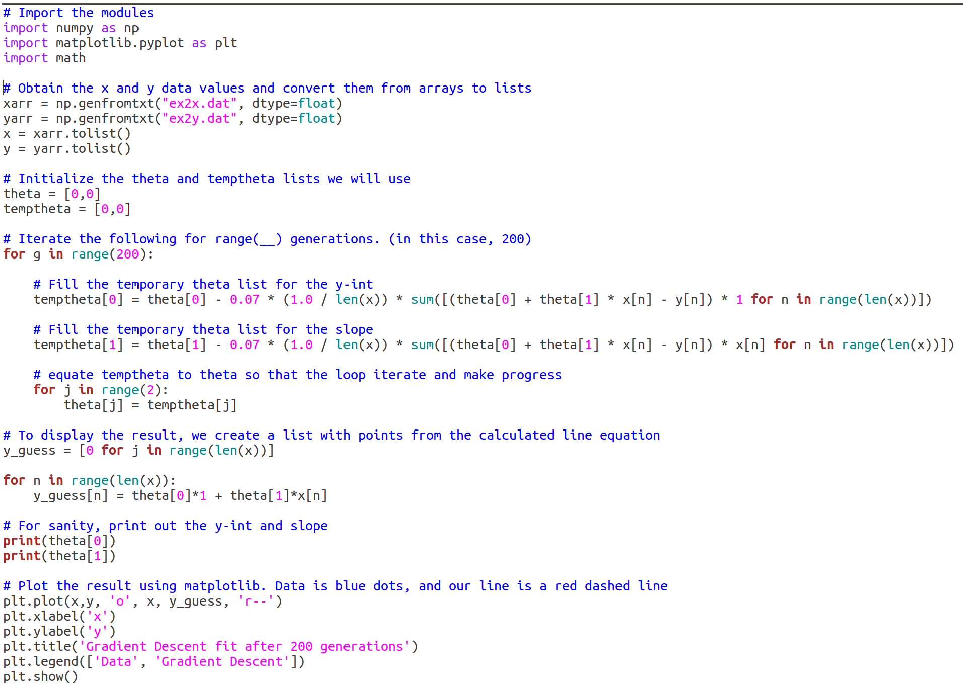
Solution 1: using just for loops

Slide 5
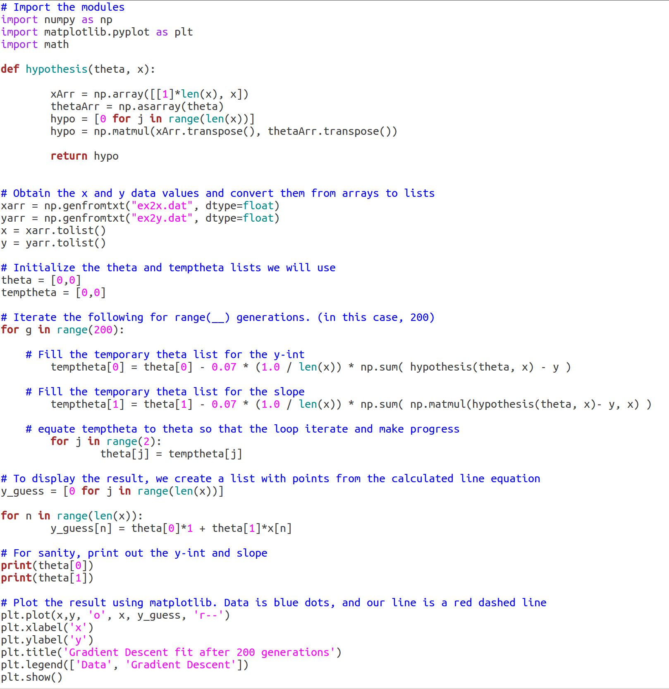
Solution 2: using matrices for the hypothesis

Slide 6
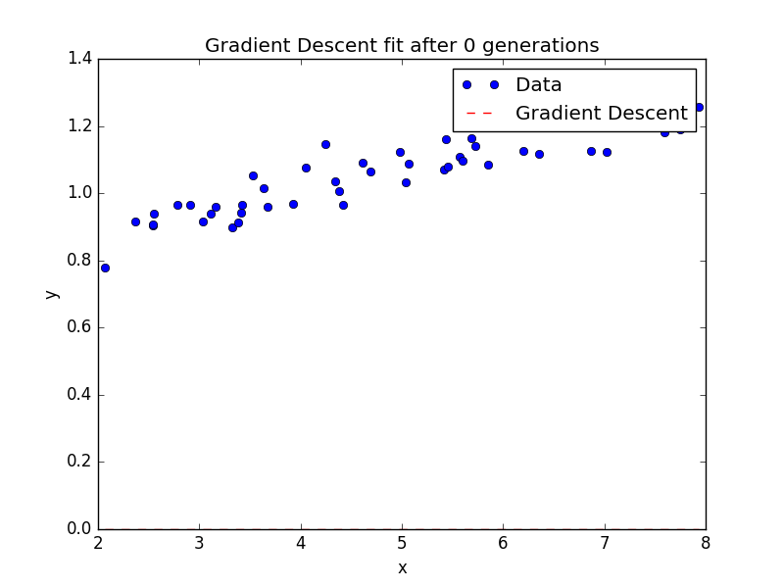
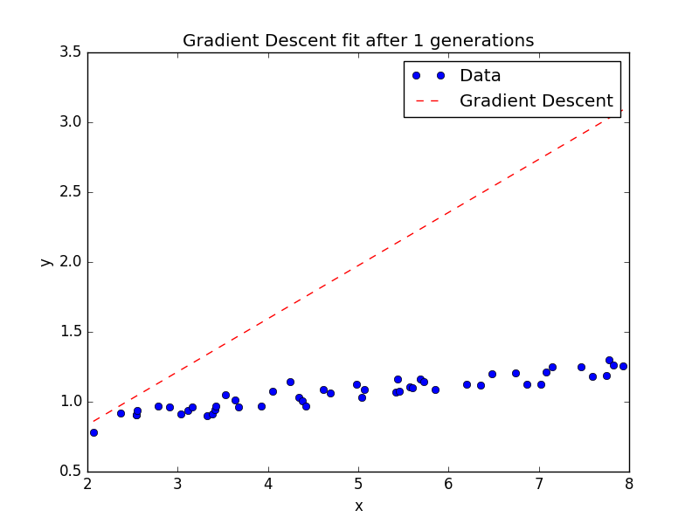
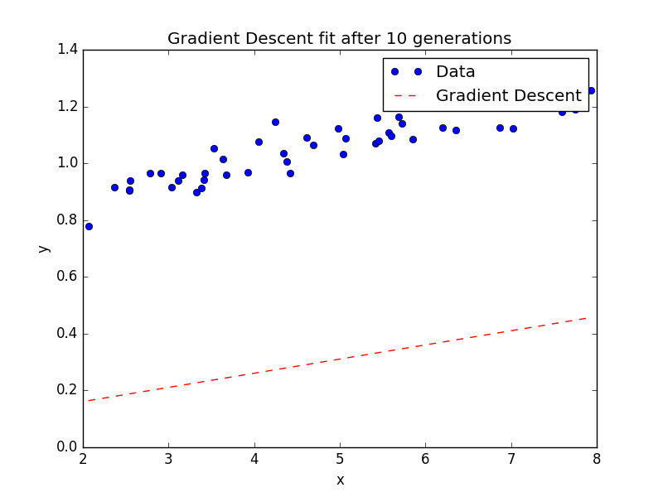
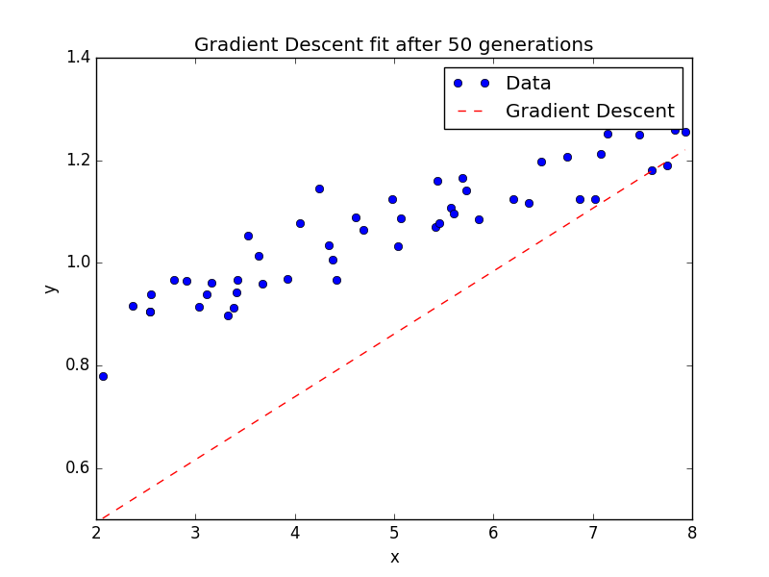
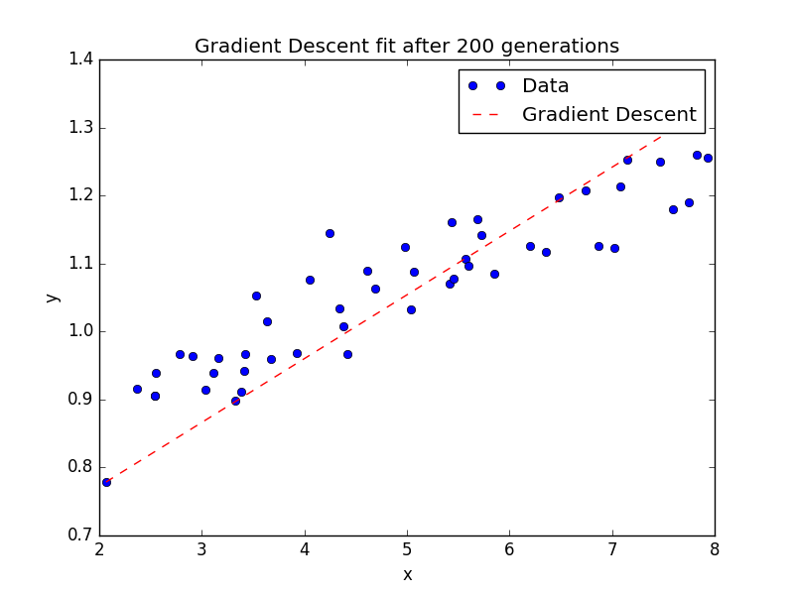
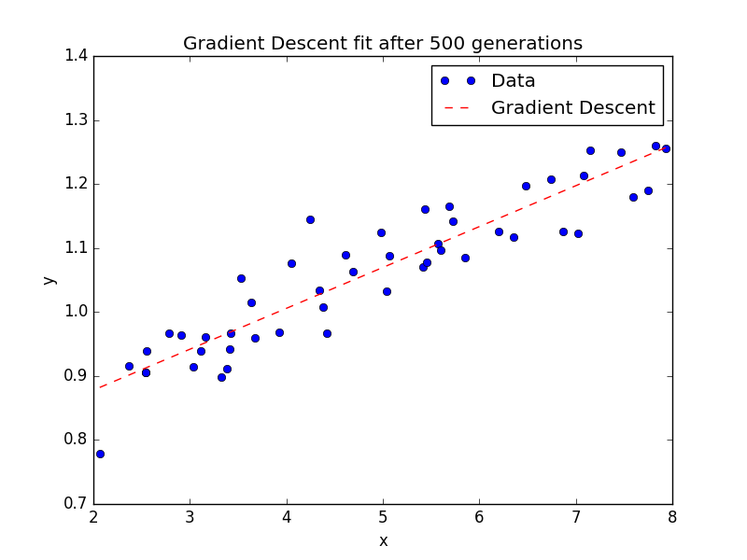
Results

Slide 7
Possible Additional Work
Create a matrix that holds the slope (theta_0) and y-intercept (theta_1) values after each evolution
Plot the contours of J(theta), the least squares error function, on a theta_1 vs. theta_0 graph
Plot the progress the Gradient Descent function makes after every iteration
Why: This would help us see if our rate of descent (in this case 0.07) is too large or small for the problem. Also, it would help us visualize what is going on in the code

